Slide 1
5th Month Presentation of New Associates
Name : Annan Hutomo Putra (2180704)
Education : Computer Engineering
Institut Pertanian Bogor
Section : Information System – Manufacturing
Date of Join : May, 7th 2018
<Contents>
The Organization Structure
One Year Schedule
Role & Responsibility
Basic & Specific Knowledge
Operational Job Description
Personal Impression and Expectation
Information System Dept.

Slide 2
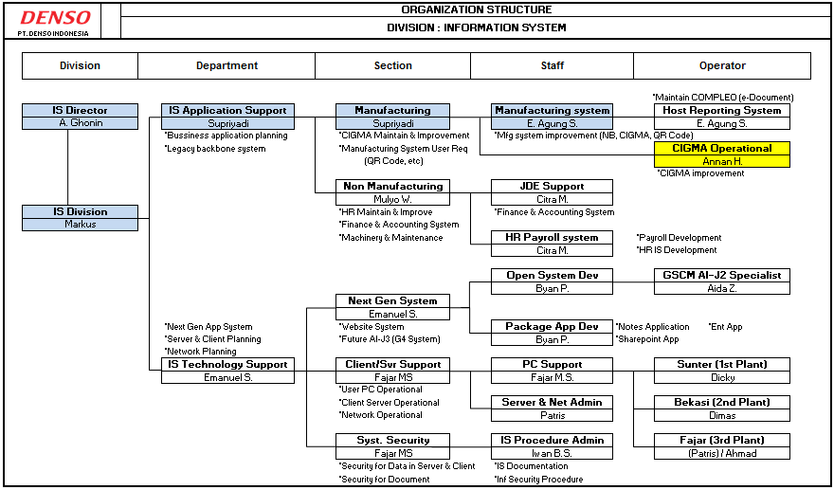
1. IS Organizational Structure
2/12
I am Assigned as IS Manufacturing in CIGMA Operational & Improvment

Slide 3
2. One Year Schedule
3/12
Activity | 2018 |  |  |  |  |  |  |  | 2019 |  |  |  | Learning Point
 | May | Jun | Jul | Aug | Sept | Oct | Nov | Dec | Jan | Feb | Mar | Apr
Orientation
Green Card Education
Engineering Development Program
Programming Knowledge
AS400 Basic
Database
RPG
DNIA System Knowledge
CIGMA
Project
Internet of Thing (IoT)
Presentation Schedule
Joined 7th May ‘18
Understood general and specific knowledge about DNIA
- Communication Skill - WSTC
- Denso Problem Solving - Leadership
Understood operation of AS400 and code of RPG with Database.
PF, LF
Create spool file
Planning, Feasibility Analysis, Software Design, Coding, .ration
Learn how to manage project, analyze and solve problem
5th Month
8th Month
Final

Slide 4

3. Role and Responsibility
4/12
Information System
CIGMA Operational & Improvment
Role
Application Support
Technology Support
Develop common technology as required by DNIA focus on inspection automation (ULCV & others)
Share skill and support to each PE on ULCV implementation
Create procedure implementation of automation inspection
Manufacturing
Non-Manufacturing
Opeational & Improvement System :
Process
Ex: Pick & Place
Logistic
Ex: AGV
Inspection
Ex: ULCV
Responsibility
Operational & Improvement System:
Productivity
Annual Plan
Budget
ESC Milestone
Factory Layout
Ensure project implementation on each product run as scheduled
Confirm data study and parameter setup in inspection automation are strongly accurate at implementation

Slide 5


4. Basic and Specific Knowledge
5/12
4.1 DNIA System Outline
AM Web Order
Customer Portal
Or Email
DCJ, D-Group
Host Reporting
DNJP
- Mail
- Workflow approval
Lotus
Domino
Generate QR Kanban by DNIA
Compleo
LINC
CBM
Monthly
D-Café
Quarterly
General Ledger
Product Data
Management
Production
plan
Customer
Order
Account Receive
Delivery
system
OCEANS
(Std,Cost)
Interface
Night Batch Processing
JD Edwards
CIGMA
Account Payable
Part & Mat’l
Requirement
Productivity
Inventory
Management
System
Interface
Fixed Asset
Export Import
System
Overtime
Purchase order system
Interface
DNIA EPS
(Procurement)
Employee Tax mgmt
Part & Mat’l
Receiving
Dom. WO
System
Time attendance
Payroll
3rd Plant Receiving Program
One Way Kanban
Personal system
(DIPSYS)
CIGMA is a computer system that manages production control activities from receiving an order to delivery at the overseas group companies.

Slide 6

4. Basic and Specific Knowledge
6/12
4.2 CIGMA
AM Web Order
Customer Portal
Or Email
DCJ, D-Group
Sell
Manufacture
Buy
Generate QR Kanban by DNIA
LINC
Product Data
Management
Production
plan
Order
Receiving
Production
Planning
Parts
Ordering
Customer
Order
DNJP
Delivery
system
Production
instruction
Night Batch Processing
Part & Mat’l
Requirement
CIGMA
Inventory
Management
System
Customer
Finish Good
W/H
Production process
Parts W/H
Export Import
System
Supplier
Purchase order system
Part & Mat’l
Receiving
Dom. WO
System
Shipping
Stock-in
Progress Control
Parts issue
3rd Plant Receiving Program
One Way Kanban
CIGMA(with DENSO concept) supports Prod. control and logistics.

Slide 7
4. Basic and Specific Knowledge
7/12
4.2 RPG

Slide 8
5. Operational Job Description
8/12
5.1 Operational

Slide 9




5. Operational Job Description
8/12
5.2 Improvment
1. Internet of Thing (IoT) Concept
Background
Problem
Target
1. User should entry facility request in print
manually form
2. Need a lot of time to approver directly
3. Need more time for Admin Facility to input
request order
4. Related person can’t check order status
5. Facility department in each plant has it
own rules to control request order
1. RO form (paper) is not used
after input
2. Take a time to bring RO to
approver
3. Time waste for Admin to input RO
4. User can’t track status of RO
5. Hard to manage central data
facility from each plant
1. Reduce need of paper (paperless)
2. Reduce time go to approver
3. Time more efficient for admin facility
without input RO
4. User can track RO status by system
5. Easier to manage central data with
database from facility in each plant
Flow Process
Current
Requester
Approver
Requester
Facility
5. Check Order
6. Input Order
to excel
7. Order
Process
1. Write Order
in paper
2. Bring Order to
approver directly
3. Check & sign Order paper
4. Bring Order to facility
Time waste to input RO
Human error
Take time to bring RO
Take time to bring PR
New
Requester
System
Approver
System
Facility
5. Check Order
in EFOS
6. Order
Process
1. Input Order
in EFOS
2. Send Order to
approver by email
3. Check & approve Order in EFOS
4. Send Order to Facility
by email
Using parallel pattern in development due to accelerate lead time implementation

Slide 10
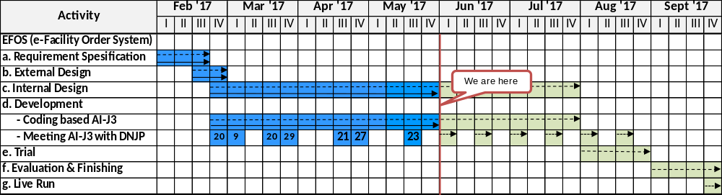

5. Operational Job Description
8/12
5.2 Improvment
2. IoT Project Planning
3. Main Activity
Requirement
Specification
External
Design
Internal
Design
Development
Trial
Evaluation
& Finishing
Live Run
Define system
flow in web
application based
Requirement def
User requirement
Screen list def
Database def
Function list
definition
Class relation
diagram
Package confi
guration def
CRUD Matrix
Create form
Approval form
Search form
FPR process
Unit test
Integration
test
System test
User
acceptance
test
Implementation
EFOS
Using parallel pattern in development due to accelerate lead time implementation

Slide 11
6. Personal Impression and Expectation
12/12
Experience & Knowledge
1. Learn how to design process manufacture and develop automation.
2. Learn how manage activity as well as on target and collaboration with other department.
3. Learn to enhance communication skill to build a strong team work with related section while running a
project
Impression
It was a great chance to be part of Denso as a global company, I learn a lot about system in manufacturing industry and Denso tradition encourage me to always get on improvement for the future.
Expectation
Short term : Continue to study development in camera inspection and make ULCV implementation
procedure.
Long term : Expand automation inspection development in all production line at DNIA

Slide 12
Thank You

